Slide 1
Survey Responses

Slide 2
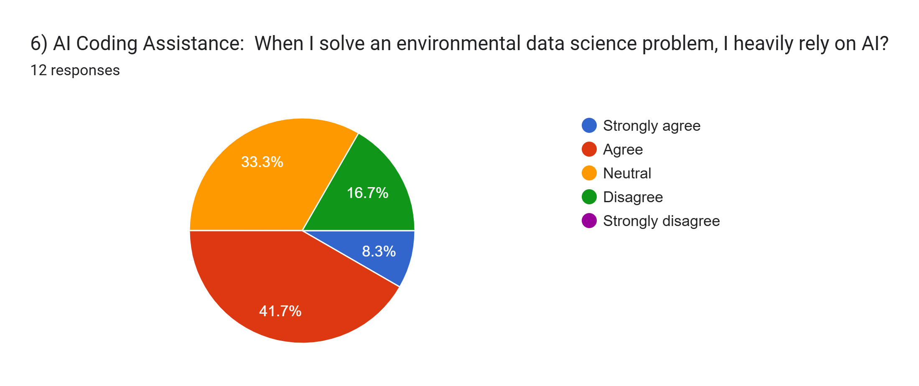

Slide 3
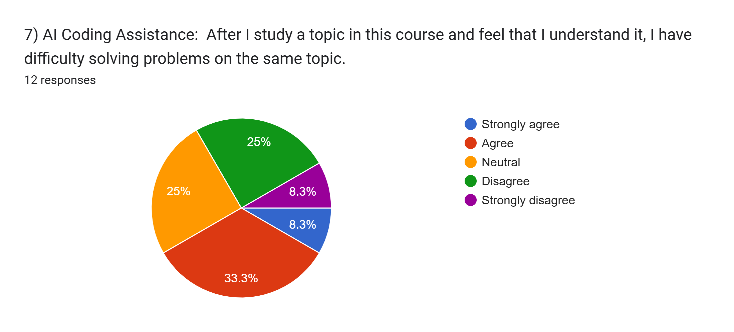

Slide 4
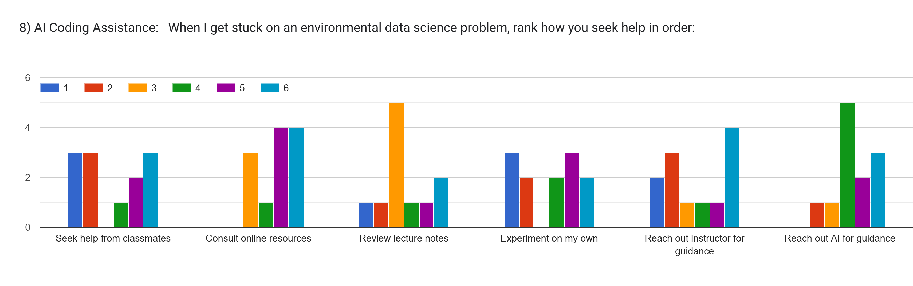
Number of responses
Number of responses
Rank

Slide 6
9) AI Coding Assistance:
How has the integration of AI coding assistance, such as Jupyter AI or ChatGPt, impacted your learning experience in the course, both positively and negatively?
12 responses
It was good to me! I like having a back up help when I can not resolver problems.
I believe it helps me solve problems and makes the class seem more helpful, instead of learning to past a test we are actually learning to solve problems.
I used ChatGPT a lot in this course. I am disappointed that Jupyter AI did not work as well for me. I feel like while I am using ChatGPT I am not learning as much as I could, so I wish I had a stronger foundation without it instead of heavily relying on it.
The use of LLM has been helpful but also lackluster as sometimes the LLM model is not structured to assist with certain things that I would need to be fixed.
It has helped a lot, I actually think more time allotted to AI coding assistance would have been an efficient use of time and would allow for less time to be focused on Pandas/NumPy/Xarray
AI coding assistance has helped me build the skeleton of my project and assisted me during homework problems.
It has allowed me to understand topics without seeking assistance first.
Negatively, it does not really help me much when I am learning extremely hard codes, and the AI give me complicated results, but the rest is positive for basic simple code.
It has positively impacted learning by helping me diagnose errors when other resources, such as stack exchange and github forums, are unclear.
Helped.
It helped me dive into the errors and understand why I was getting them and how to fix them.
Jupiter AI was unhelpful because it did not work. chatgpt was slightly helpful but it would be bad if i became too reliant on it

